Slide 1
Volcanoes
Guaranteed to blow your mind
Data Analysis Presentation by Lucy Burns
CodeClan Cohort D12
March 16th 2022

Slide 2
Presentation Content
Data
Questions and Analysis
Summary
The Future

Slide 3
Data Sources
Primarily from a Tidy Tuesday set – a weekly data project aimed at the R ecosystem
Tidy Tuesday Data:
Eruptions
Events
Sulfur
Tree rings
Volcano
Other Data:
Explanation of the VEI scale
Number of recorded deaths from eruptions

Slide 4
Data Cleaning
The Tidy Tuesday datasets were very clean to begin with
- a few unnecessary fields were removed
- the data was joined and amended as needed
The VEI (Volcanic Explosive Index) table needed a little formatting so it could be matched to the other datasets.
The death database needed a lot of editing to match volcano names

Slide 5
Questions
Question One: Where are volcanic eruptions likely to occur
Geographic location
Elevation
Notes:
Question One: Where are volcanic eruptions likely to occur? Start by looking at the geographic location and also the elevation

Slide 6
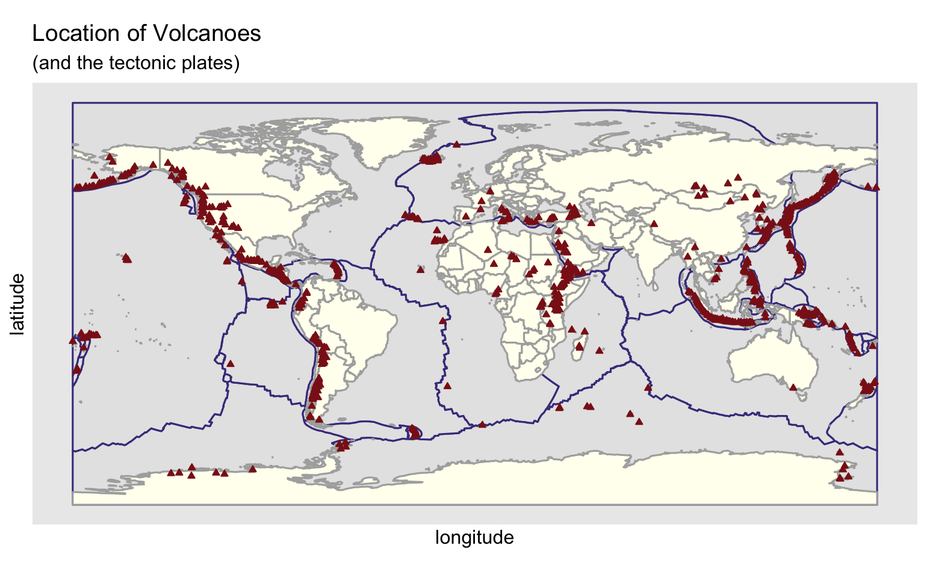
Geographic Location
The location of volcanoes follow the tectonic plates across the earth
The ring of fire around the Pacific Ocean is especially noticeable as volcanic
Notes:
75% of the volcanoes are situated along the Ring of Fire

Slide 7
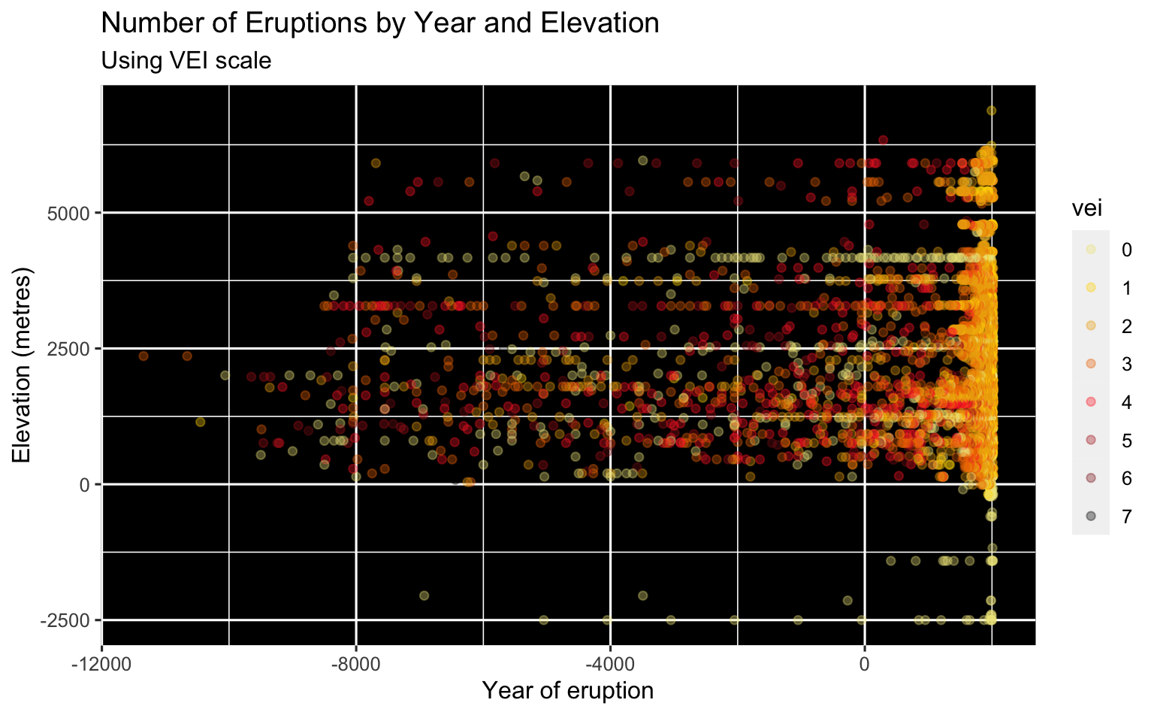
elevation
Straight line pattern shows repeated eruptions of the same volcano
Many more eruptions noticeable since 1800s
91% have a VEI of 3 or lower
Of all the known eruptions in the past 10,000 years only 8 had a VEI of 7
No discernible pattern otherwise
Notes:
VEI count
0 1006 12%
1 1390 17%
2 4034 48%
3 1154 14%
4 506 6%
5 178 2%
6 52 1%
7 8 0%
8328

Slide 8
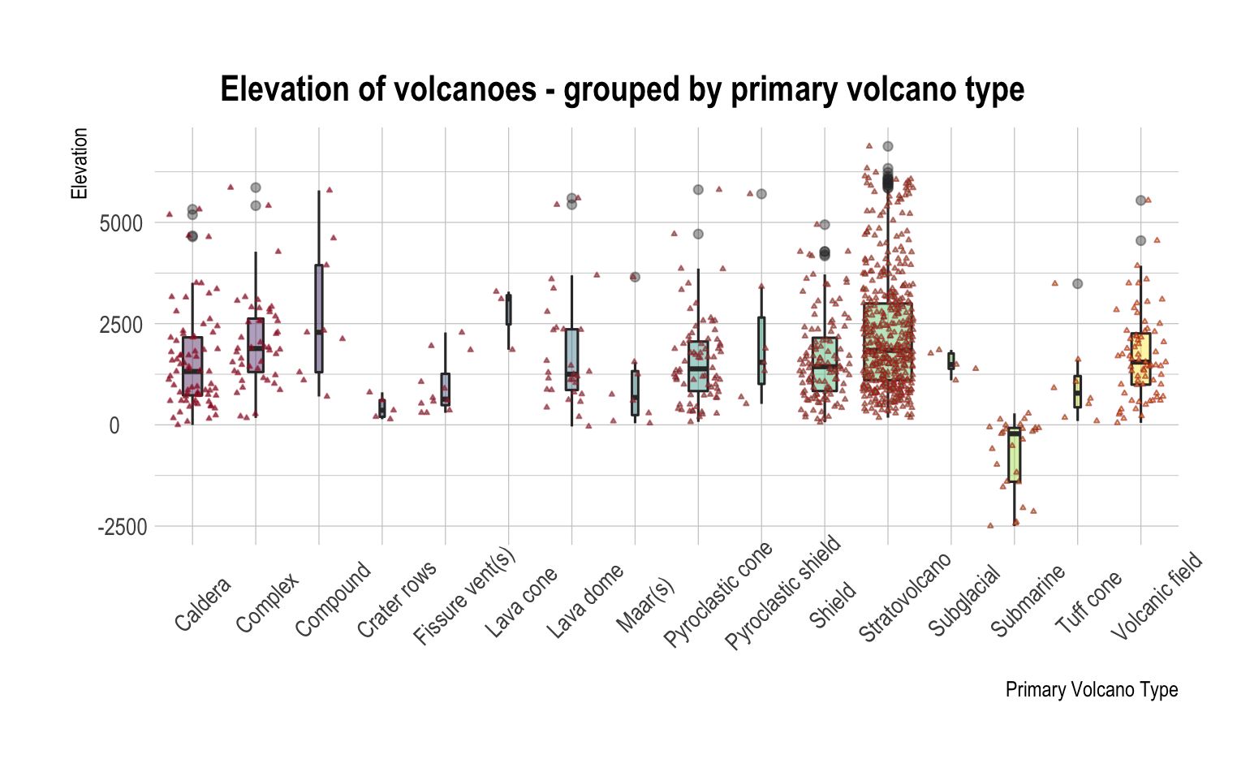
Elevation by volcano type
No real pattern noticeable
Majority of the volcanoes are stratovolcanoes
Subglacial volcanoes can be seen to be below 0m elevation
Notes:
48% are stratovolcanoes
12% are shield volcanoes

Slide 9
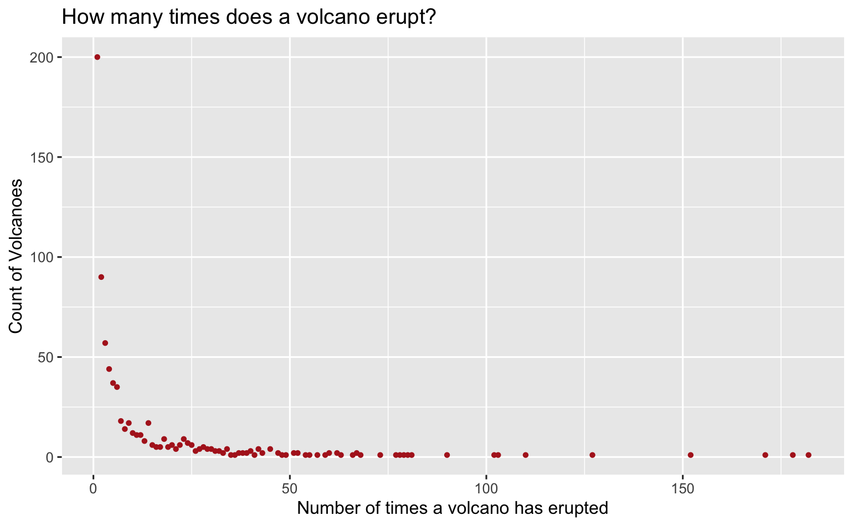
Number of eruptions by volcano
27% have only erupted once
72 % have erupted 10 times or fewer
96 % have erupted 50 times or fewer
But 8 have known to have erupted over 100 times
Notes:
The majority of volcanoes erupt rarely (from what we know)
- 27% have only erupted once
- 72% 10 or fewer eruptions
- 83% 20 or fewer
- 95% 50 or fewer
But there are some volcanoes that we know erupt a lot.
8 of the volcanoes have known to have erupted at least 100 times.

Slide 10
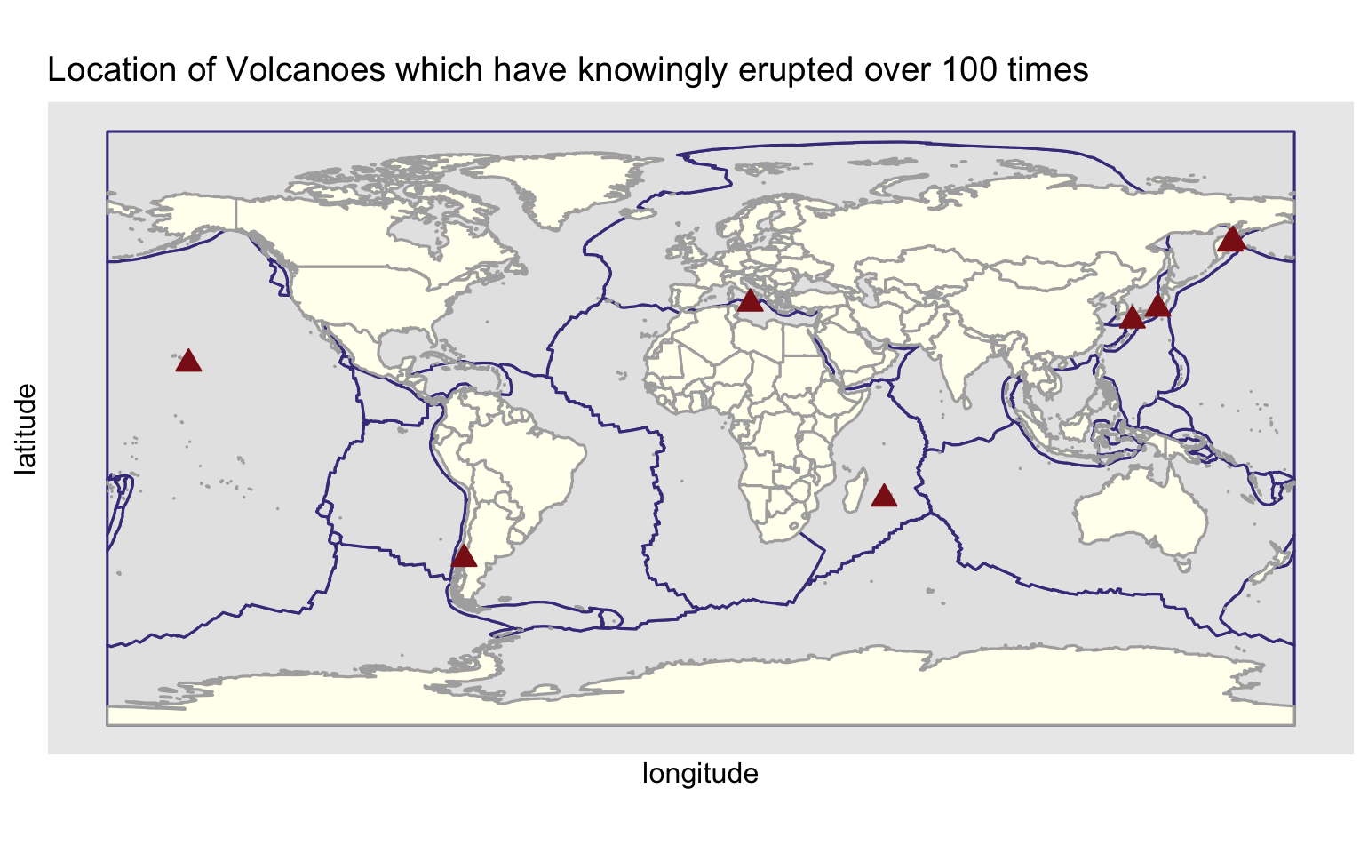
Repeat erupters
No. Eruptions | Volcano | Last Eruption | Country
182 | Piton de la Fournaise | 2020 | France
178 | Asosan | 2020 | Japan
171 | Etna | 2020 | Italy
152 | Villarrica | 2020 | Chile
127 | Asamayama | 2019 | Japan
110 | Mauna Loa | 1984 | US
103 | Klyuchevskoy | 2020 | Russia
102 | Sheveluch | 2020 | Russia

Slide 11
Questions
Question One:
Where are volcanic eruptions likely to occur
Question Two:
Which volcanoes are likely to cause the most damage if they blow?
Geographic location
Elevation
Summary:
Volcanoes are located along the tectonic plates
75% are located on the Ring of Fire, circling the Pacific Ocean
Some volcanoes erupt many, many times but most hardly ever
Nearby population
Deaths from previous eruptions
VEI of last volcano eruption

Slide 12
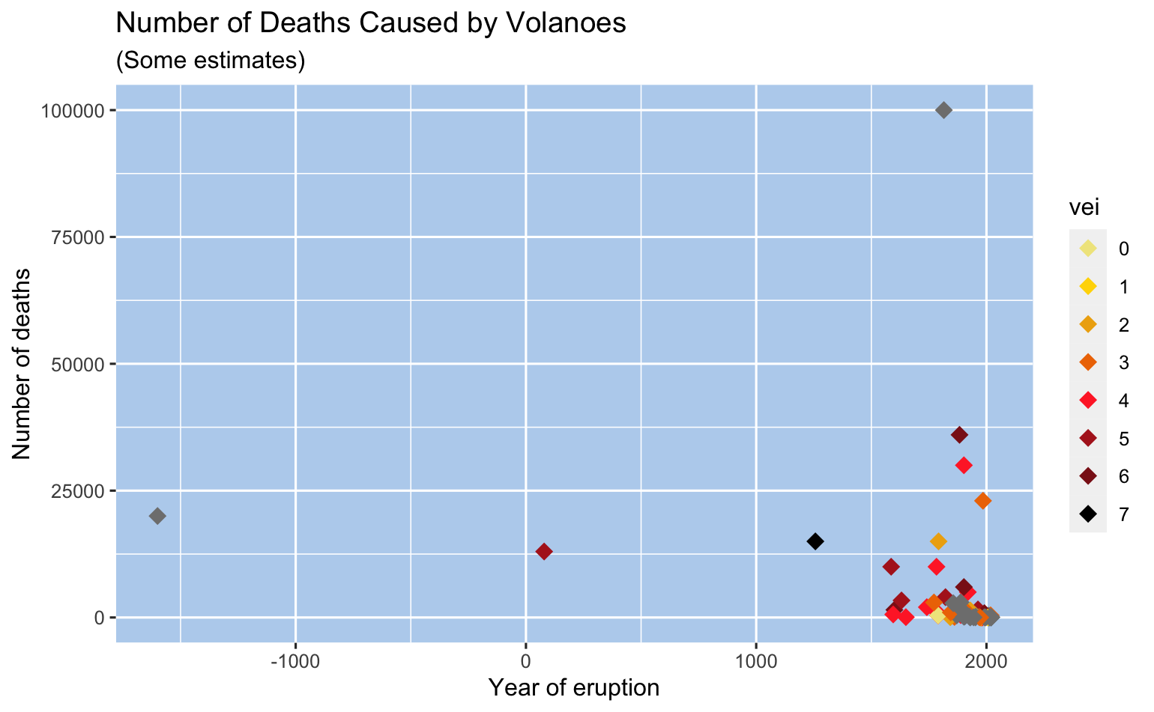
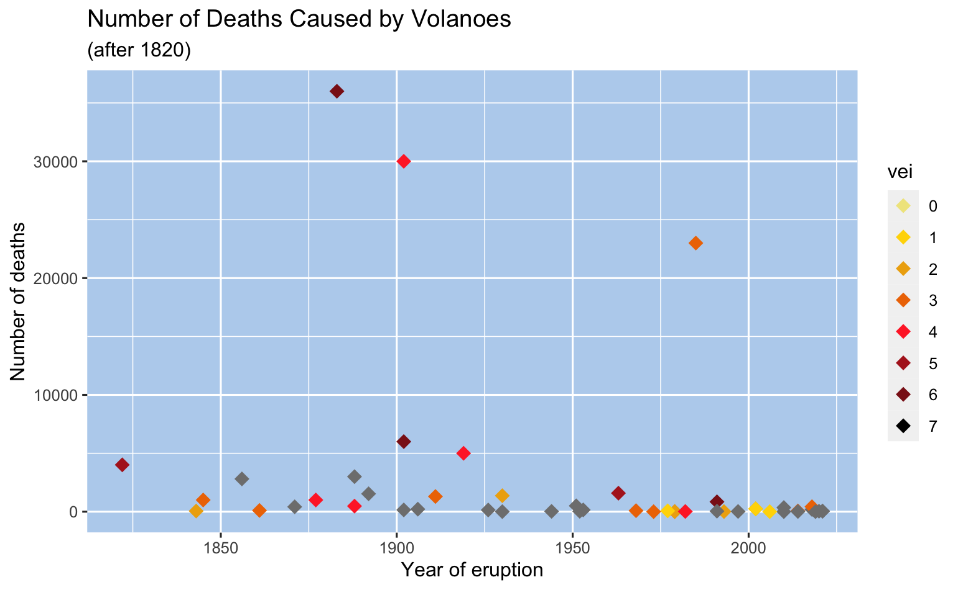
Deaths caused by volcanoes
All known deaths
After 1820
Note this one:
1815 – approximately 100,000 deaths, VEI of 7
Notes:
Graph One – Note the large count in 1815 – approximately 100,000 people killed
Graph Two – Three large counts are apparent
1883 Krakatoa in Indonesia, 36,000 killed
1902 Pelee in Martinique, 30,000 killed
1985 Nevado del Ruiz in Colombia, 23,000 killed
Note greys are where the datasets didn’t match up – NAs

Slide 13
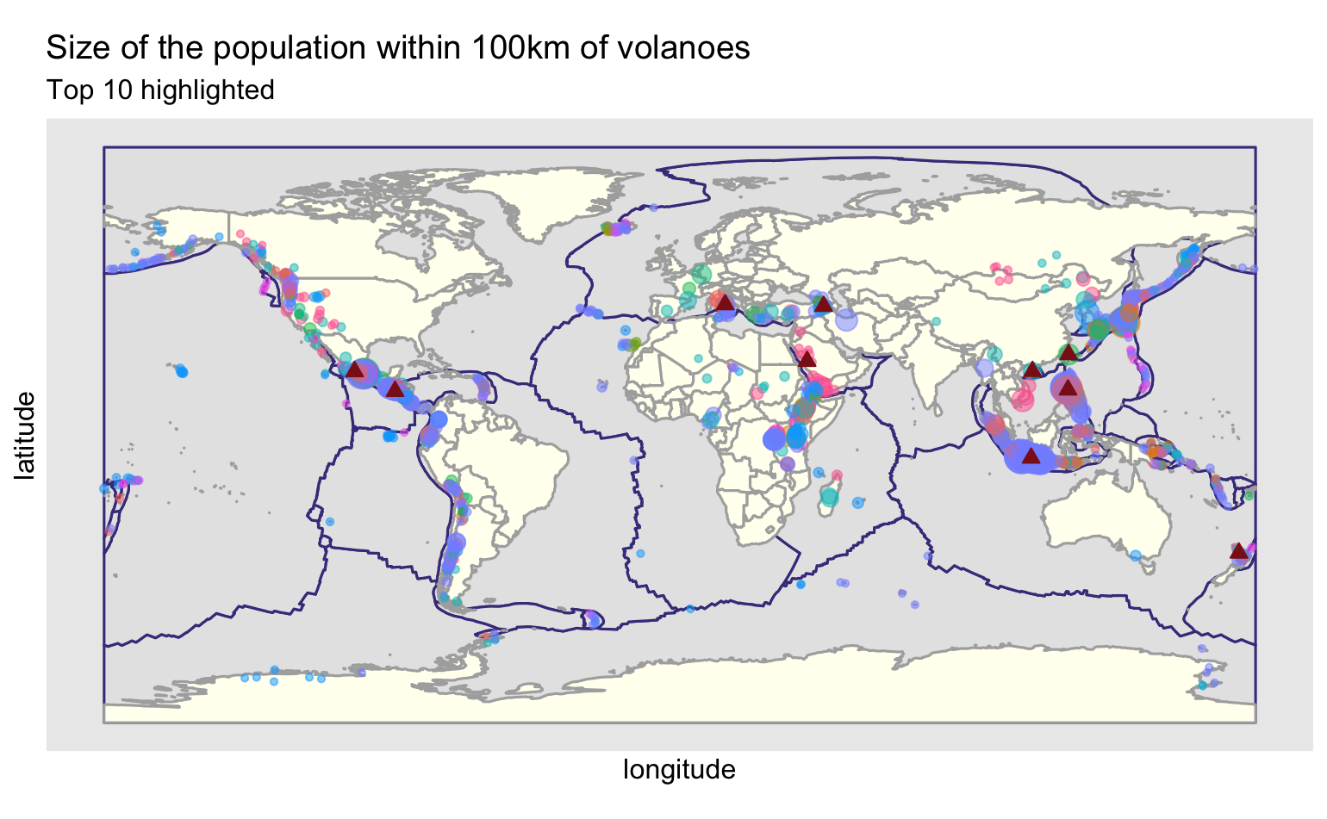
Population
10 volcanoes have over 1 million people living within 10km
Volcano Name | Country | Population within 10km
Michoacan-Guanajuato | Mexico | 5783287
Tatun Volcanic Group | Taiwan | 5084149
Campi Flegrei | Italy | 2234109
Ilopango | El Salvador | 2049583
Hainan Volcanic Field | China | 1731229
San Pablo Volcanic Field | Philippines | 1349742
Ghegham Volcanic Ridge | Armenia | 1265153
Dieng Volcanic Complex | Indonesia | 1092929
Auckland Volcanic Field | New Zealand | 1049110
Rahat, Harrat | Saudi Arabia | 1010115
Notes:
At present, about 800 million people live within 100 km of an active volcano - a distance well within reach of potentially lethal volcanic hazards. Of these, about 200 million are in Indonesia

Slide 14
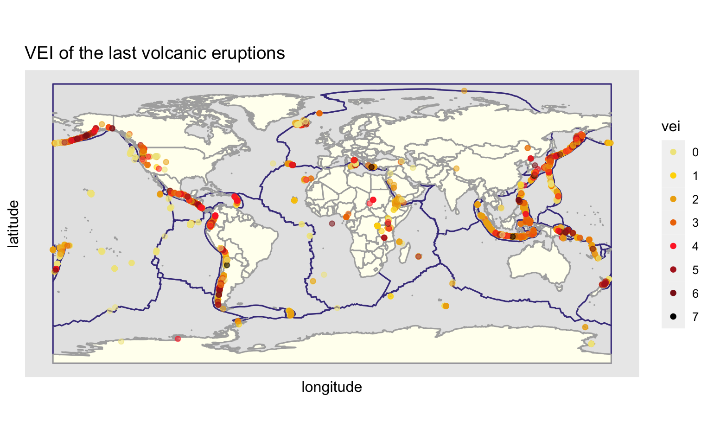
VEI index
Notes:
Majority are 3 and lower as previously seen – we can see some of the larger ones – look at Indonesia especially. Tambora

Slide 15
Questions
Question One:
Where are volcanic eruptions likely to occur
Question Two
Which volcanoes are likely to cause the most damage if they blow?
Question Three
Why do people live near volcanoes when they are so lethal?
Geographic location
Elevation
Summary:
Volcanoes are located along the tectonic plates
75% are located on the Ring of Fire, circling the Pacific Ocean
Nearby population
Deaths from previous eruptions
VEI of last volcano eruption
Summary:
Those with the largest population nearby
Those with the highest eruption level
Tourism
Geo-thermal benefits
Minerals
Other Reasons

Slide 16
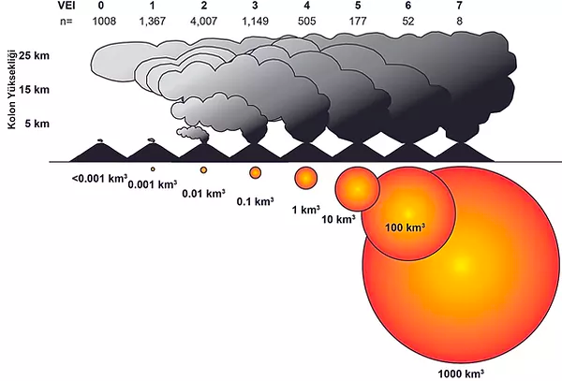
Vei Index
The number below the scale value shows how many eruptions have been recorded in each VEI bracket in the last 10,000 years.
https://www.turkvolc.com/eruption-size

Slide 17
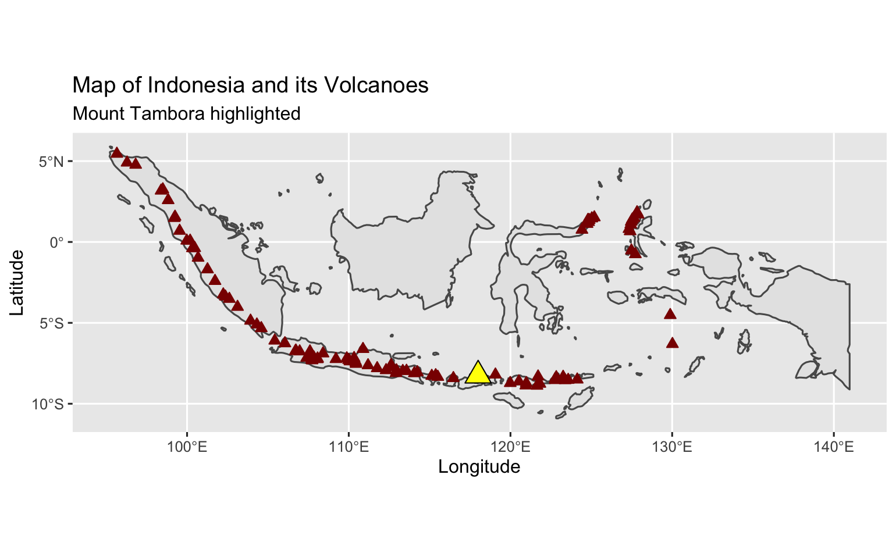
Indonesia volcanoes
Notes:
The majority of Indonesia's volcano are located on a 3,000 km long chain called the Sunda Arc. Here, the subduction of the Indian Ocean crust underneath the Asian Plate produced most of these volcanoes.
Indonesia has 147 volcanoes and 76 of them are active volcanoes

Slide 18
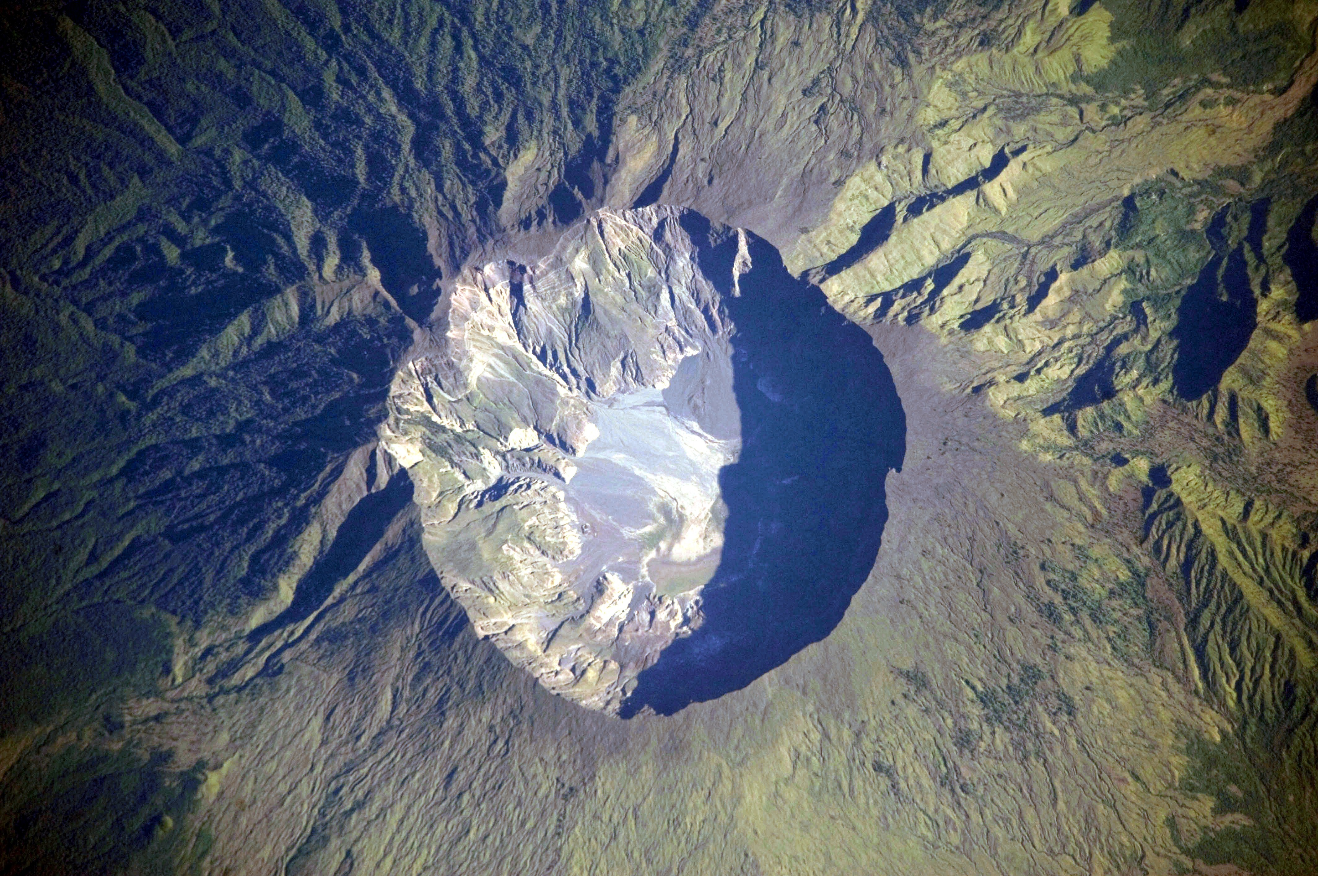
Mount Tambora
Erupted in 1815
Deadliest eruption in recorded history
The caldera (crater) created is 4 miles across
The explosion immediately killed around 10,000 people
Believed to eventually have killed some 100,000 people
Triggered ‘The Year Without a Summer’
Image : NASA
Notes:
The deadliest eruption in recorded history was the 1815 explosion of Mount Tabora in Indonesia. The blast was one of the most powerful ever documented and created a caldera—essentially a crater—4 miles across and more than 3,600 feet deep. A superheated plume of hot ash and gas shot 28 miles into the sky, producing numerous pyroclastic flows when it collapsed.
The eruption and its immediate dangers killed around 10,000 people. But that wasn't its only impact. The volcanic ash and gas injected into the atmosphere obscured the sun and increased the reflectivity of Earth, cooling its surface and causing what's known as the year without a summer. Starvation and disease during this time killed some 82,000 more people, and the gloomy conditions are often credited as the inspiration for gothic horror tales, such as Mary Shelley's Frankenstein.

Slide 19
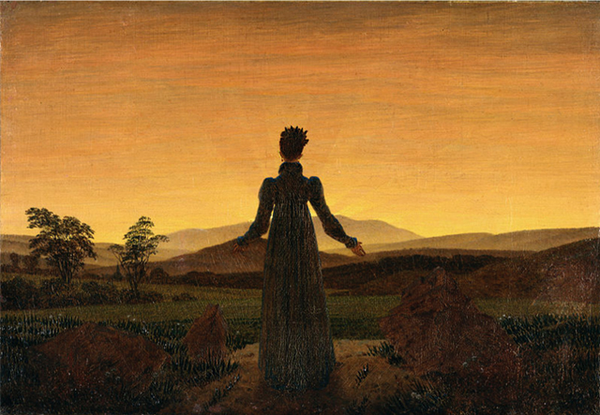
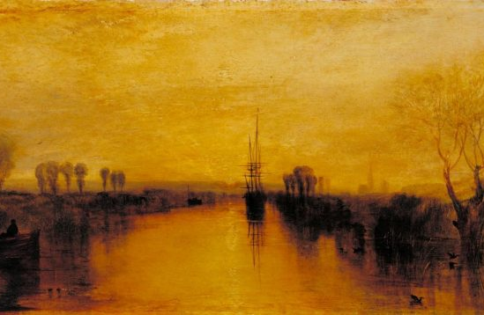
The year without a summer
Europe's summer temperatures were the coldest on record since 1766.
There were northern hemisphere food shortages
Record numbers of people starved to death in Paris in 1816
There was famine in China, the monsoon season was disrupted causing widespread flooding in the Yangtze valley.
Paintings of the time showed the colour of the sky as yellow
Mary Shelley wrote Frankenstein
Woman before the Setting Sun 1818 by Caspar David Friedrich (Image: TATE)
Chichester Canal by William Turner Image: TATE
Notes:
These bleak circumstances hit hardest in and around the Alpine regions of France, Germany, Austria, and Switzerland.
Mary Shelley: “It proved a wet, ungenial summer… and incessant rain often confined us for days to the house”
Geneva had been struck by flooding and famine, and soup kitchens were opened for the poor. There is evidence of the appalling weather in the group’s writings of the time. Mary observed that “the thunder storms that visit us are grander and more terrific than I have ever seen before.” Favored mountain roads remained impassable, and their evening pastime of rowing on Lake Geneva was often impossible because of strong gales and heavy rains. The perpetual heaviness of what should have been summer skies inspired Byron’s miserable lyric “Darkness,” in which the sun is permanently extinguished, and mankind dies:
All earth was but one thought—and that was death, Immediate and inglorious; and the pang Of famine fed upon all entrails—men Died, and their bones were tombless as their flesh;
The meagre by the meagre were devoured

Slide 20
Questions
Question One:
Where are volcanic eruptions likely to occur
Question Two
Which volcanoes are likely to cause the most damage if they blow?
Question Three
Why do people live near volcanoes when they are so lethal?
Geographic location
Elevation
Summary:
Volcanoes are located along the tectonic plates
75% are located on the Ring of Fire, circling the Pacific Ocean
Nearby population
Deaths from previous eruptions
VEI of last volcano eruption
Summary:
Those with the largest population nearby
Those with the highest eruption level
Tourism
Geo-thermal benefits
Minerals
Other Reasons
Summary:
Often people have no choice in where they live
Volcano tourism is a money-spinner

Slide 21
The future
48 volcanoes were in continuing eruption status at the beginning of 2022
Approximately 20 volcanoes are erupting on any particular day
AI and machine learning is being used to predict eruptions
BUT – at the moment undergraduate students are still better at picking out eruptions than the machines
Notes:
Overall, 48 volcanoes were in continuing eruption status as of 27 January 2022. An eruption marked as "continuing" does not always mean persistent daily activity, but indicates at least intermittent eruptive events without a break of 3 months or more. Detailed statistics are not kept on daily activity, but generally there are around 20 volcanoes actively erupting on any particular day; this is a subset of the normal 40-50 with continuing eruptions. Source: https://volcano.si.edu/gvp_currenteruptions.cfm
Volcanologists can predict eruptions—if they have a thorough understanding of a volcano's eruptive history, if they can install the proper instrumentation on a volcano well in advance of an eruption, and if they can continuously monitor and adequately interpret data coming from that equipment.
https://www.nature.com/articles/d41586-019-00752-3

Slide 22
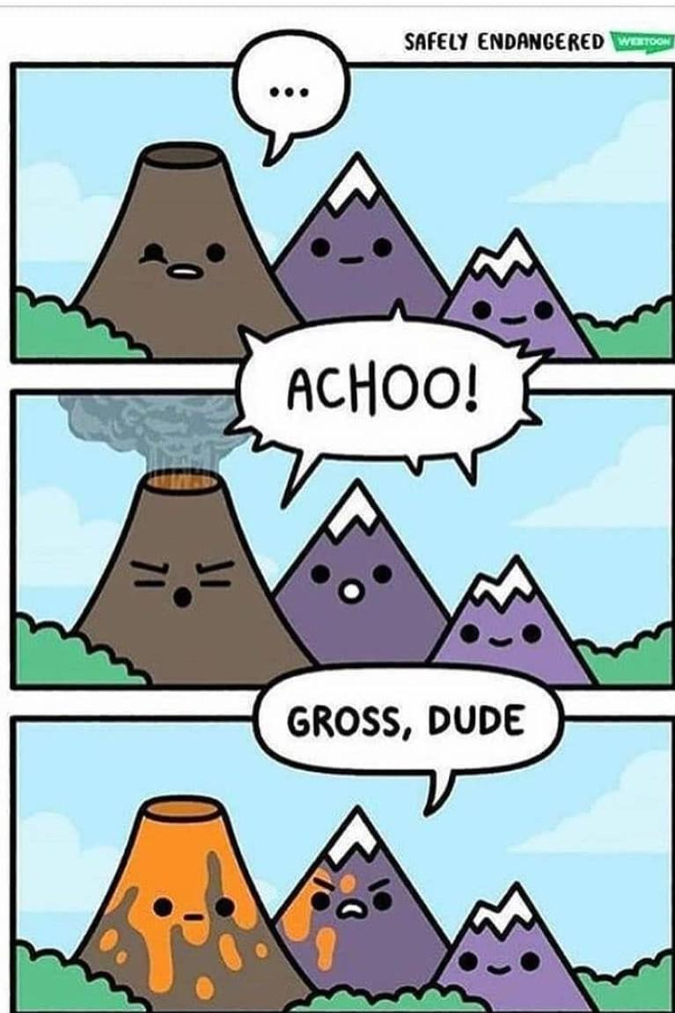
Learnings
I didn’t use the tree ring or sulphur datasets for analysis
Some of the datasets were messier than I first thought and caused problems when matching
Start earlier
Predictive modelling a possibility for the future but the unpredictability of volcanoes makes this very, very difficult
Notes:
Other scientists, such as Matt Pritchard, a volcanologist at Cornell University in Ithaca, New York, are trying to develop algorithms that can spot changes in volcanoes using other types of satellite data, such as surface temperature or ash and gas emissions⁴. Working with Biggs and others, Pritchard hopes to use machine-learning techniques to sift through 17 years of data from NASA’s Terra and Aqua satellites, which measure heat coming off erupting volcanoes on Earth.
But he and his colleagues are just getting started with their algorithms, which have a long way to go. For now, at least, undergraduate students are much better than the machines at picking out eruptions.

Slide 23
References/Acknowledgements
Tidy Tuesday Data
National Geographic
Getty Images (main photo)
How AI and satellites could help predict volcanic eruptions
The Characteristics of Volcanic Eruption in Indonesia

Slide 24
Thank You

